Slide 1
AUXILIARY OUTREACH BECKY KIEFFER CHAIRMAN BKISO2012@GMAIL.COM

Slide 2
HEY
THERE
FLORIDA !!

Slide 3


DEPARTMENT AND NATIONAL AWARDS

Slide 4

REQUIREMENT # 1:
GET YOUR PARTNERSHIP APPROVED AT AN AUXILIARY MEETING AND RECORDED IN MINUTES

Slide 5

REQUIREMENT #2
WEAR AN AUXILIARY HAT, SHIRT, NAME TAG, SOMETHING THAT IDENTIFIES YOU AS PART OF YOUR POST
This Photo by Unknown Author is licensed under CC BY-NC

Slide 6

REQUIREMENT #3
REPORT IT ON THE DEPARTMENT PAGE

Slide 7


NO $$$$$ YES HOURS

Slide 8
SO WHAT DO WE WRITE IN REPORTS:
1. VOTED AND APPROVED THE PARTNERSHIP AT A MONTHLY MEETING
2. WE WORE AUXILIARY CLOTHING
3. HOW MANY MEMBERS PARTICIPATED

Slide 9
4. DESCRIBE EXACTLY HOW YOU HELPED YOUR PARTNER ACHIEVE THEIR GOALS
(INCLUDE DATE OF EVENT)

Slide 10
5. USED HASHTAGS:
#AUXILIARYOUTREACH
#AUXILIARIESINACTION
#AUXINACTION

Slide 11
WHERE’S
THE
PICS???

Slide 12
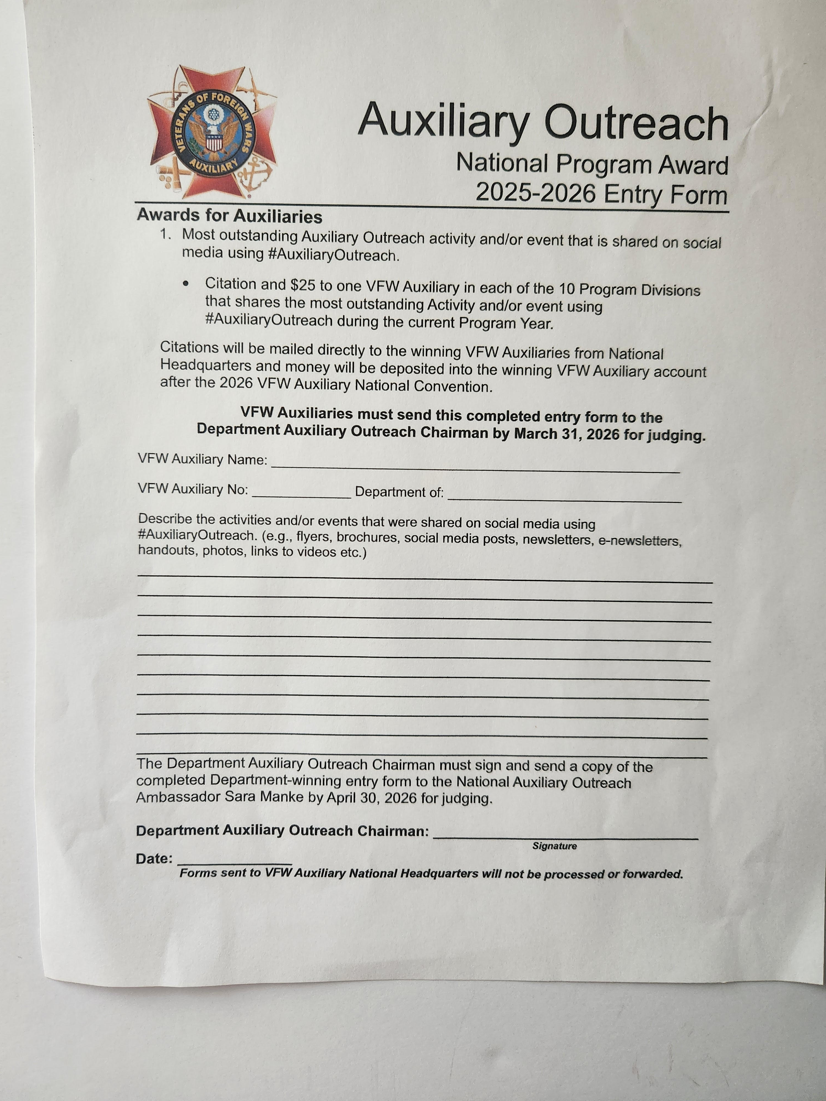
HOW DO I FIND THE NATIONAL AWARD FORM

Slide 13

HOW DO I FILL IT OUT?????

Slide 14

WHERE, HOW, TIMEFRAME

Slide 15

BECKY BEGGING……..

Slide 16
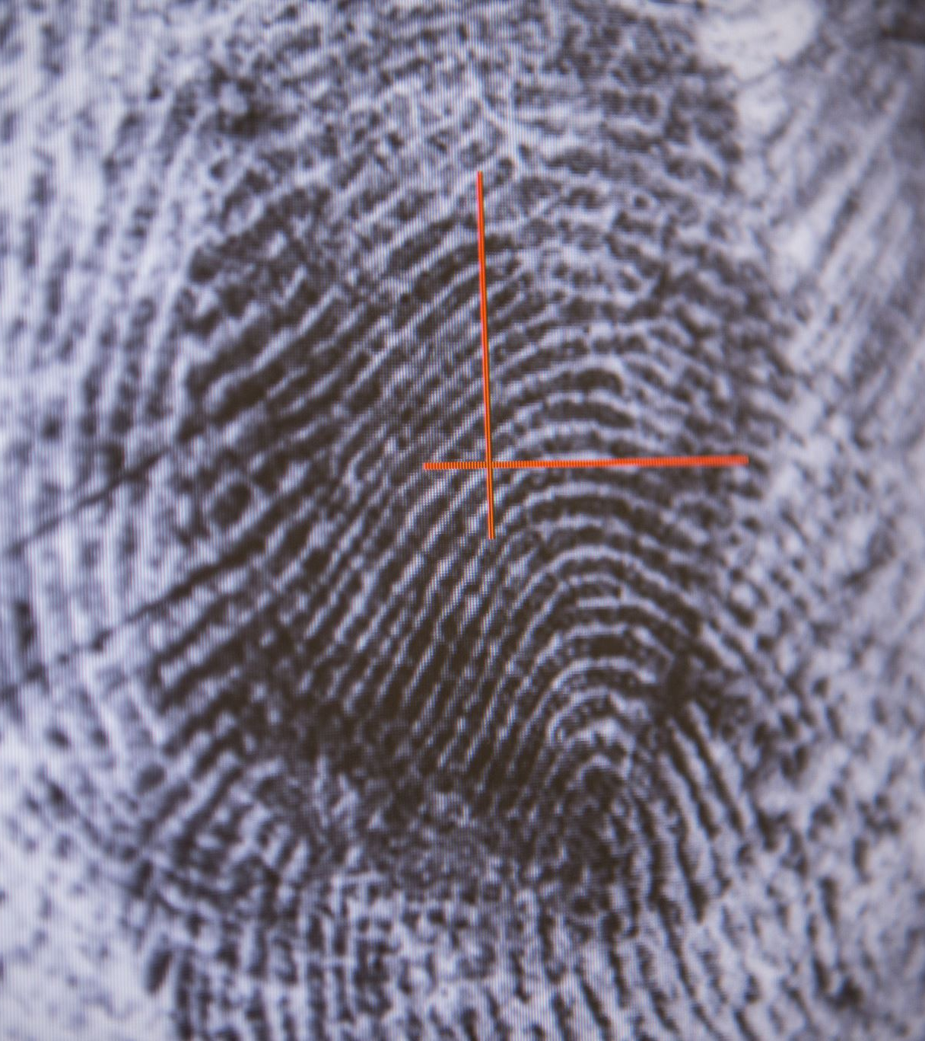
RECOGNITIONS

Slide 17

ARE YOU A BEACON OF LIGHT??
OR ARE YOU PUTTING OUT THE FLAME??

Slide 18

ARE YOU BUILDING BRIDGES FOR OUR VETERANS ?????
OR ARE YOU BUILDING WALLS
?????

Slide 19


